Slide 1

STORE MANAGEMENT SYSTEM
Database Management Systems Mini Project
Satvik Sharma [RA2211029010003]
S Gagan [RA2211029010010]
Anitej Mishra [RA2211029010023]

Slide 2
PROBLEM STATEMENT
Develop a Store Management System to streamline inventory tracking, sales recording, and customer management processes for retail stores.
The system should facilitate efficient management of product stock levels, sales transactions recording, and customer information maintenance.
Key functionalities include inventory updates, sales records, and customer management, with the capability to generate insightful reports to aid decision-making.
The goal is to enhance operational efficiency, improve customer satisfaction, and optimize inventory management within retail stores.

Slide 3
CONTENTS
Design Thinking Approach
Entity-Relationship Diagram
Tables and Values
Complex Queries
Normalization
Concurrency Control
API and Front End

Slide 4

DESIGN THINKING APPROACH
The following are the Design Thinking Tools that have been implemented in our project till now:
Design the Problem (Empathise)
Research and Ideation (Define)
Prototyping (Ideate)
Implementation
These are the tools which will be implemented as per the user’s usage pattern:
User Feedback (Prototype)
Testing
User Validation
Documentation
Reflection and Iteration
Final Presentation

Slide 5
DESIGN THINKING APPROACH
DESIGN THE PROBLEM and EMPATHISE
Store owners often resort to pen-and-paper or basic file systems to manage stock, bills, employees, sales, and purchase records, leading to inefficiency and tediousness.
Implementing a robust Store Management System (SMS) is crucial, benefiting the business, store owner, and indirectly, customers in the long run.
RESEARCH, IDEATION and DEFINE
Businesses utilizing an SMS are notably more efficient and faster compared to those without it. Owners using an SMS experience business growth and customer retention.
All the while those without an SMS observe slowdowns and customer loss. Implementation of an SMS is vital for business sustainability and growth.

Slide 6
DESIGN THINKING APPROACH
PROTOTYPING
To develop an SMS for this issue, stakeholders such as the owner/manager, suppliers, customers, and store staff first need to be identified.
Utilizing ER diagrams as prototypes, we can assess the current situation's impact on these stakeholders. Implementing an SMS will positively impact them, paving the way for developing and testing a basic SMS solution.
IMPLEMENTATION
We must determine the optimal approach for developing the SMS and its associated databases.
Utilizing ER Diagrams and Database schemas will aid in this process.
For our project, we have selected MySQL as the database management system.

Slide 7
ENTITIES
STORE
STORE MANAGER
STORE OWNER
STORE STAFF
INVENTORY
SUPPLIER
REPRESENTATIVE
TAXES
ORDERS
BILLS
CUSTOMER
CUSTOMER FEEDBACK
LOYALTY PROGRAM MEMBERS
PURCHASE REGISTER
SALES REGISTER

Slide 8
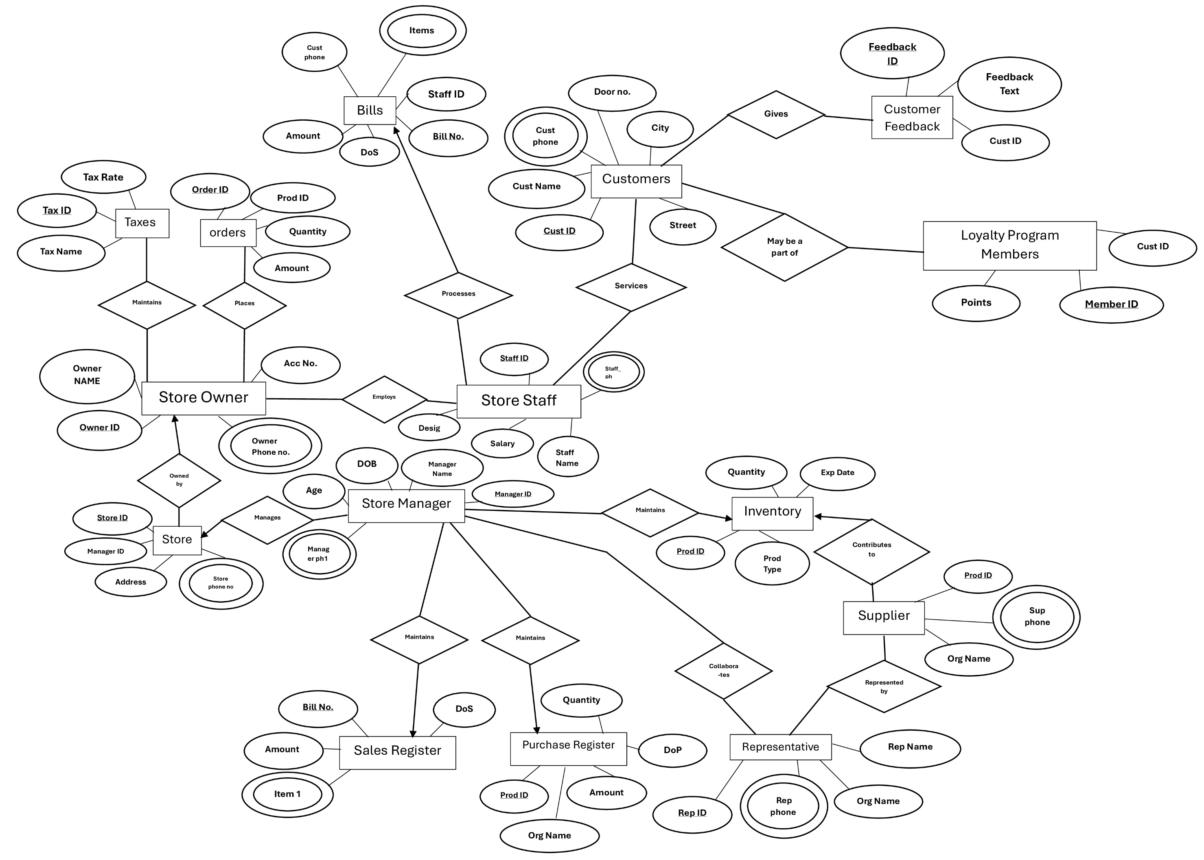
ENTITY-RELATIONSHIP MODEL

Slide 9
CREATING TABLES AND ADDING VALUES
Example: Loyalty Members
Creating the Table…
Adding Values to it…
CREATE TABLE Loyalty_members (
Member_ID INT PRIMARY KEY,
Cust_ID INT,
Points INT,
FOREIGN KEY (Cust_ID) REFERENCES Customer(Cust_ID)
);
INSERT INTO Loyalty_members (Member_ID,Cust_ID, Points) VALUES
(1, 1, 100), (2, 2, 50),
(3, 3, 75),
(4, 4, 200),
(5, 5, 150);

Slide 10
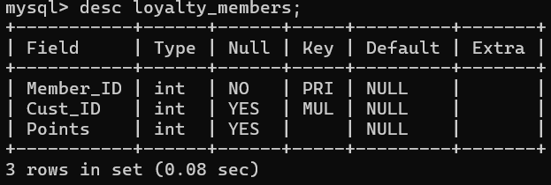
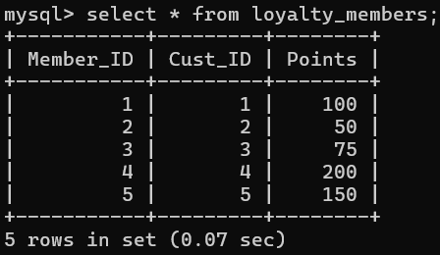
CREATING TABLES AND ADDING VALUES
Result
After Creating the Table…
After Adding Values to it…

Slide 11
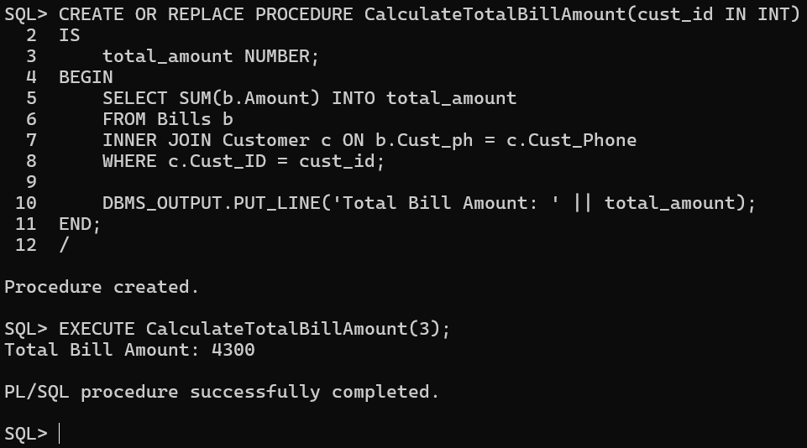
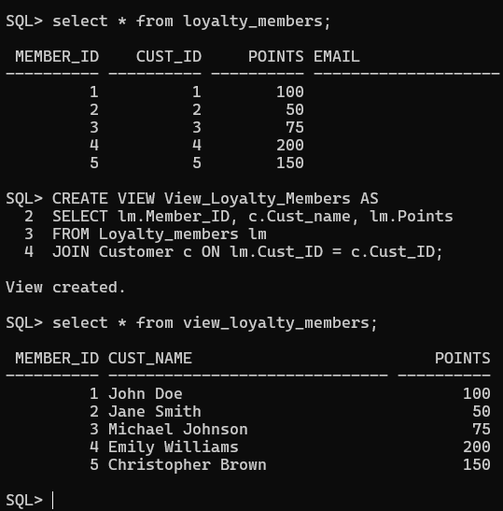
COMPLEX QUERIES
PL/SQL
Calculate Total Sales of a Customer
VIEWS
Loyalty Member

Slide 12
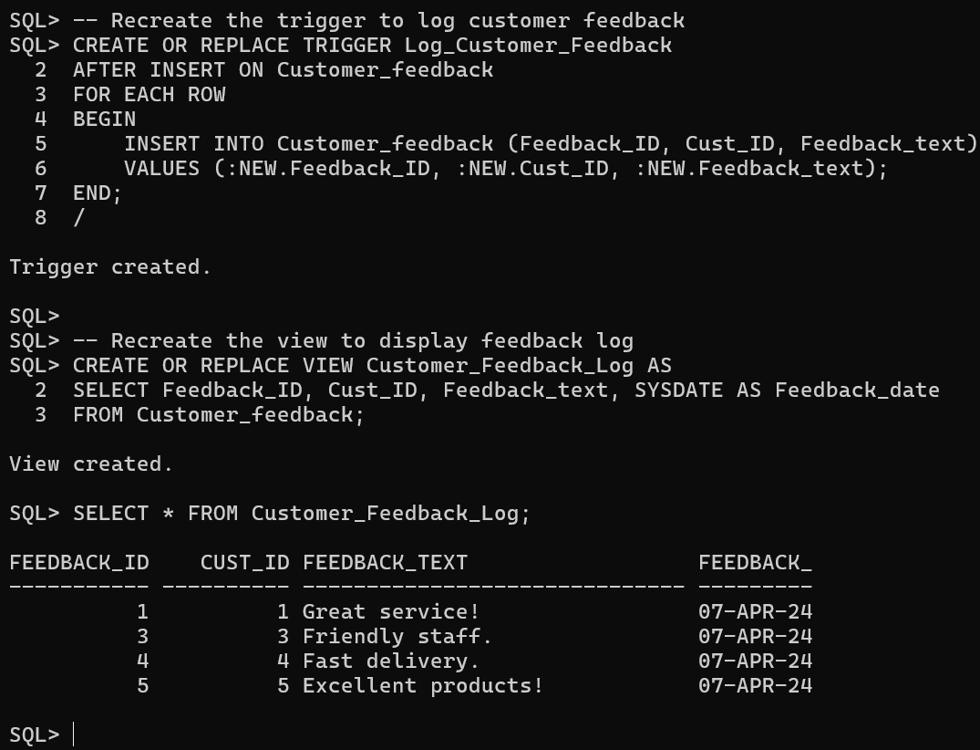
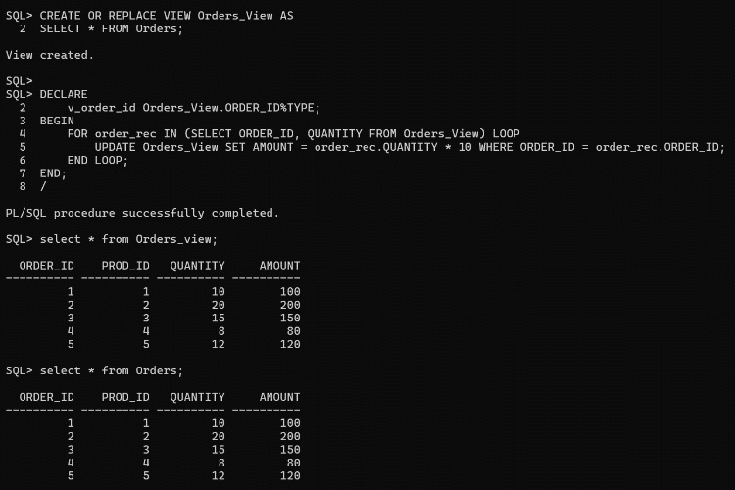
COMPLEX QUERIES
TRIGGERS
Capturing and Displaying Customer Feedback
CURSORS
Creating an Orders/View with Amount=Quantity*10

Slide 13
NORMALIZATION
Example: Taxes
Functional Dependencies:
Tax_id → Tax_rate
Tax_id → Tax_name
There is a transitive dependency in Tax_id → Tax_name:
Tax_id is not super key
Tax_name is not prime
We can apply 3NF and decompose the above table into ‘Taxes_names’ and ‘Taxes_rates’.

Slide 14
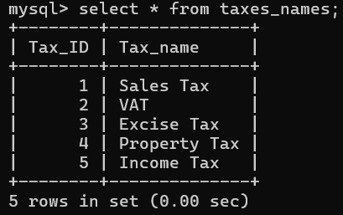
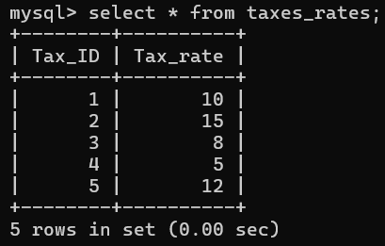
DECOMPOSED & NORMALIZED TABLES
TAXES_NAMES
TAXES_RATES

Slide 15
CONCURRENCY CONTROL: CONCURRENT TRANSACTIONS
Update the tax rate for Sales Tax from 10 to 9, and update the tax rate for VAT from 15 to 14 in “taxes” table

Slide 16
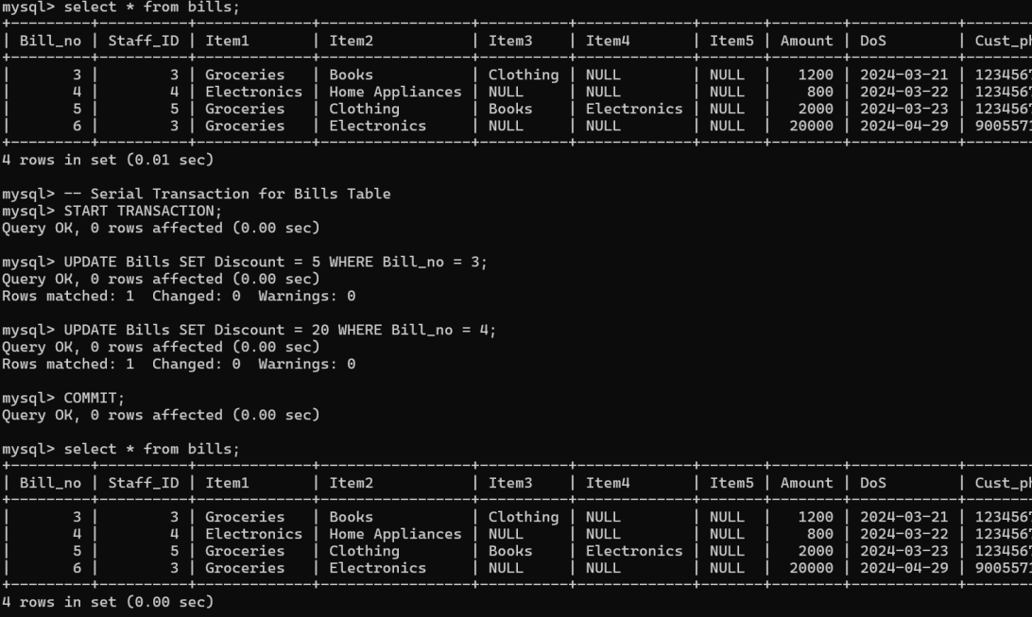
CONCURRENCY CONTROL: SERIAL TRANSACTIONS
Update the discount for Bill 3 from 0 to 5, and update the discount for Bill 4 from 25 to 20 in “bills” table

Slide 17
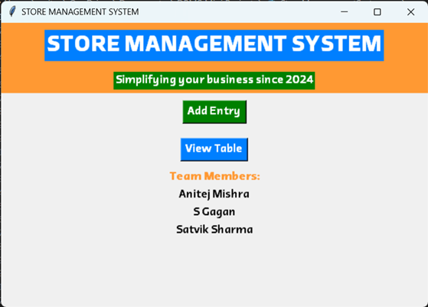
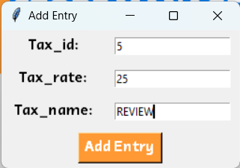
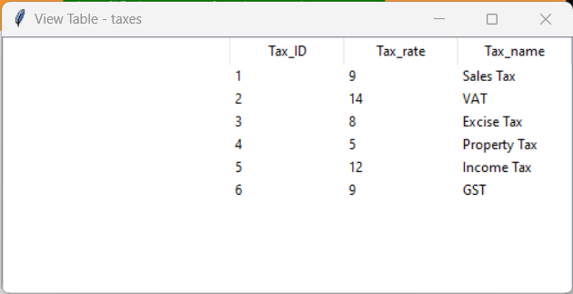
FRONT END AND API
USING PYTHON AND TKINTER

Slide 18

THANK YOU!
By Anitej Mishra, S Gagan and Satvik Sharma

